Slide 1
ESMValTool v2.11.0 release
Emma Hogan, Chris Billows, Ed Gillett
ESMValTool workshop, DLR
Monday, May 27, 2024
09:45 - 10:15
Notes:
+ Chris, Ed and I will share our experiences of performing the ESMValTool release.
+ Spoiler alert: we haven’t finished it yet!

Slide 2

Emma
Notes:
+ It was the Met Office’s first time performing an ESMValTool release.
+ We were supported by the previous release manager (Bouwe) and V.

Slide 3


Emma
30 hours!
Notes:
+ We started with the ESMValCore release.
+ Can you guess how long we spent on it?
+ Chris and Emma spent ~30 hours working together on the ESMValCore release.

Slide 4
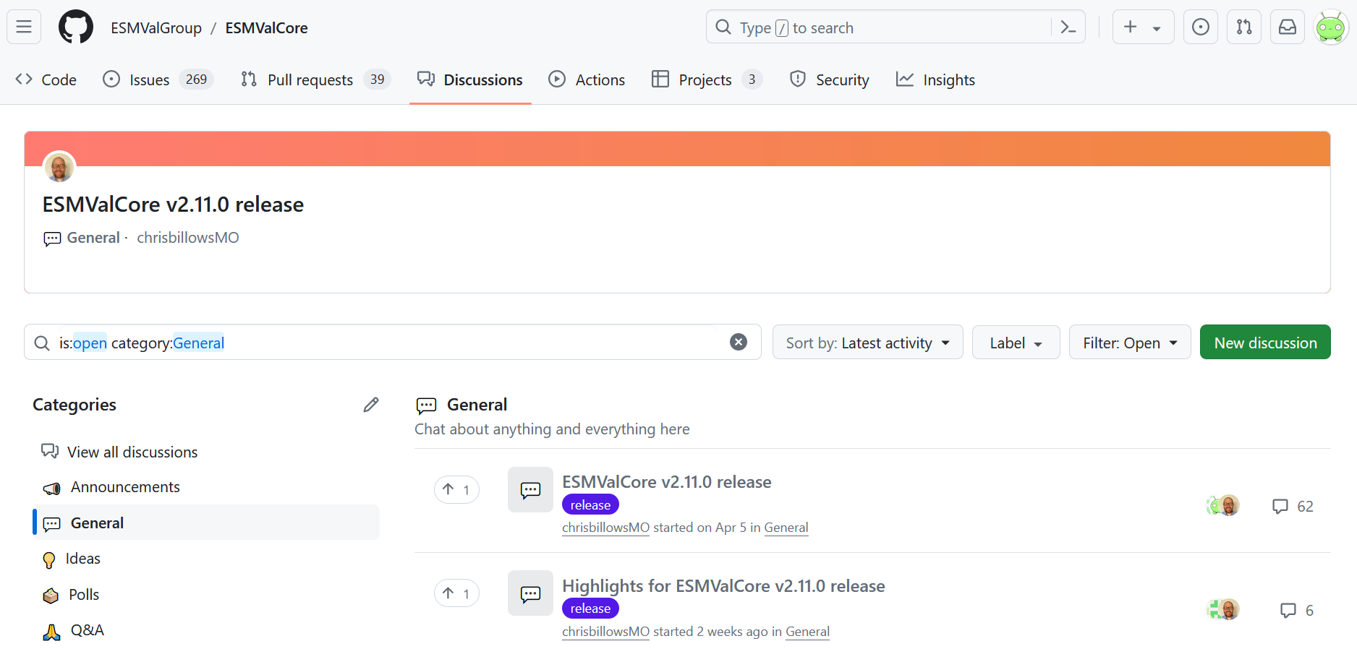
https://github.com/ESMValGroup/ESMValCore/discussions
Notes:
+ We thoroughly documented everything we learnt from conversations with Bouwe and V on the “ESMValCore v2.11.0 release” discussion, if anyone is interested!
+ You can see where we spent those 30 hours!

Slide 5

Emma
Notes:
+ We wanted to share some things about the release process that we enjoyed!

Slide 6

Emma
Notes:
+ Automation!

Slide 7
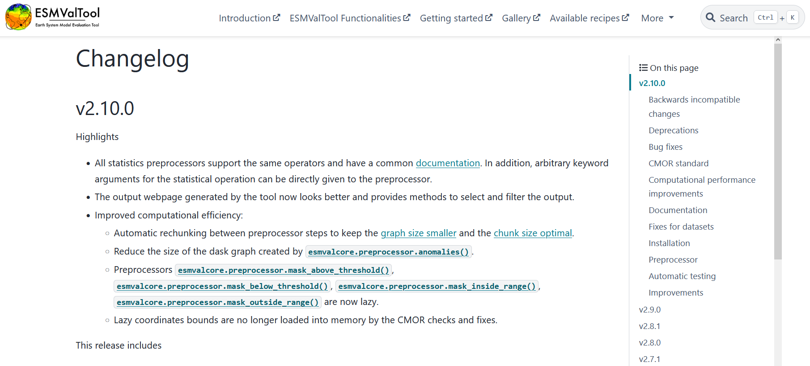
https://docs.esmvaltool.org/projects/ESMValCore/en/v2.10.0/changelog.html
Notes:
+ How many of you have read the changelog that is included with every new release?

Slide 8
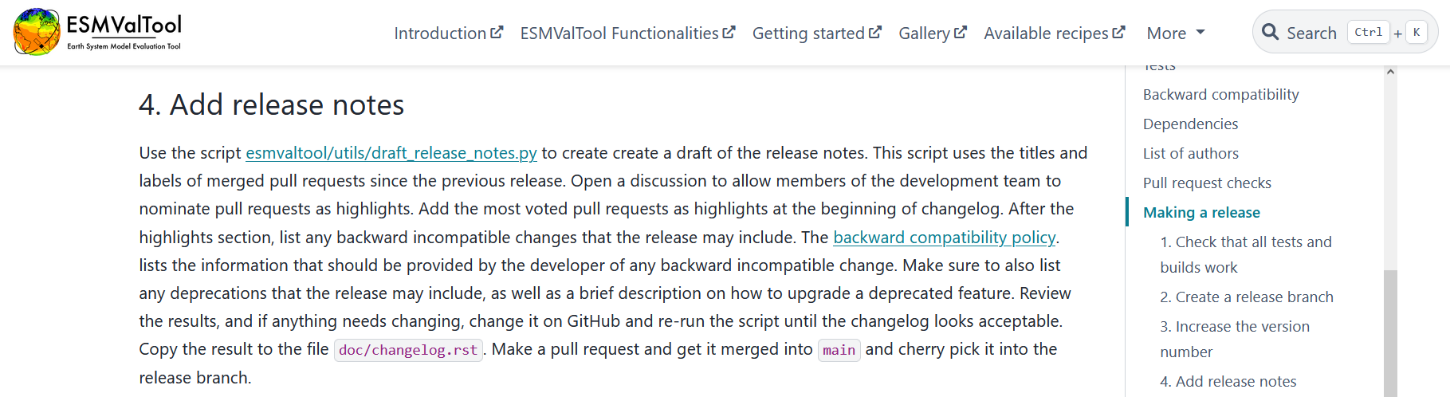
https://docs.esmvaltool.org/projects/ESMValCore/en/latest/contributing.html#add-release-notes
Notes:
+ Did you know there is a script to automatically create the changelog?
+ The script gets all the PRs merged since the last release and formats them so they can be added directly to the documentation, which was great!

Slide 9
Grouped by label!
Notes:
+ Did you know that the changes in the changelog are grouped by label?
+ The release manager appreciates when you add labels to your PRs as it helps with creating the changelog!

Slide 10

Emma
Notes:
+ When a tag is created ...

Slide 11
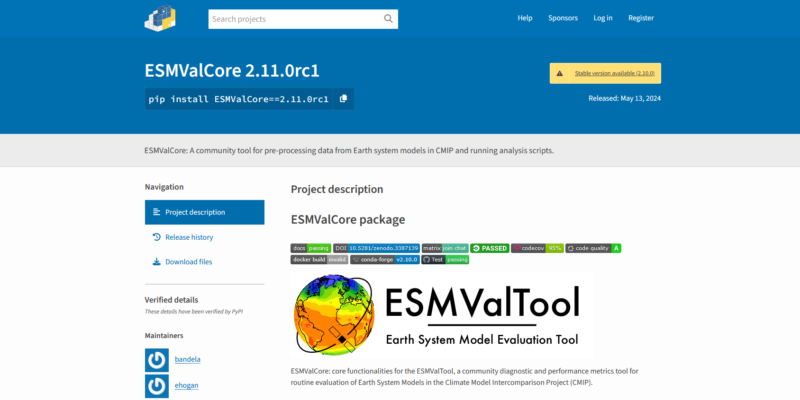
https://pypi.org/project/ESMValCore/2.11.0rc1/
Notes:
+ ... the tagged version of the package is automatically uploaded to PyPI!

Slide 12
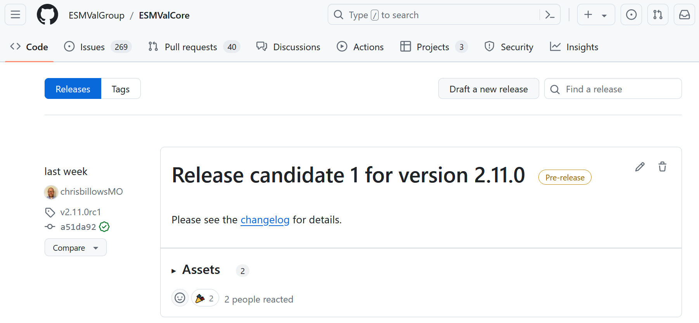
https://github.com/ESMValGroup/ESMValCore/releases
Notes:
+ When a release is made ...

Slide 13
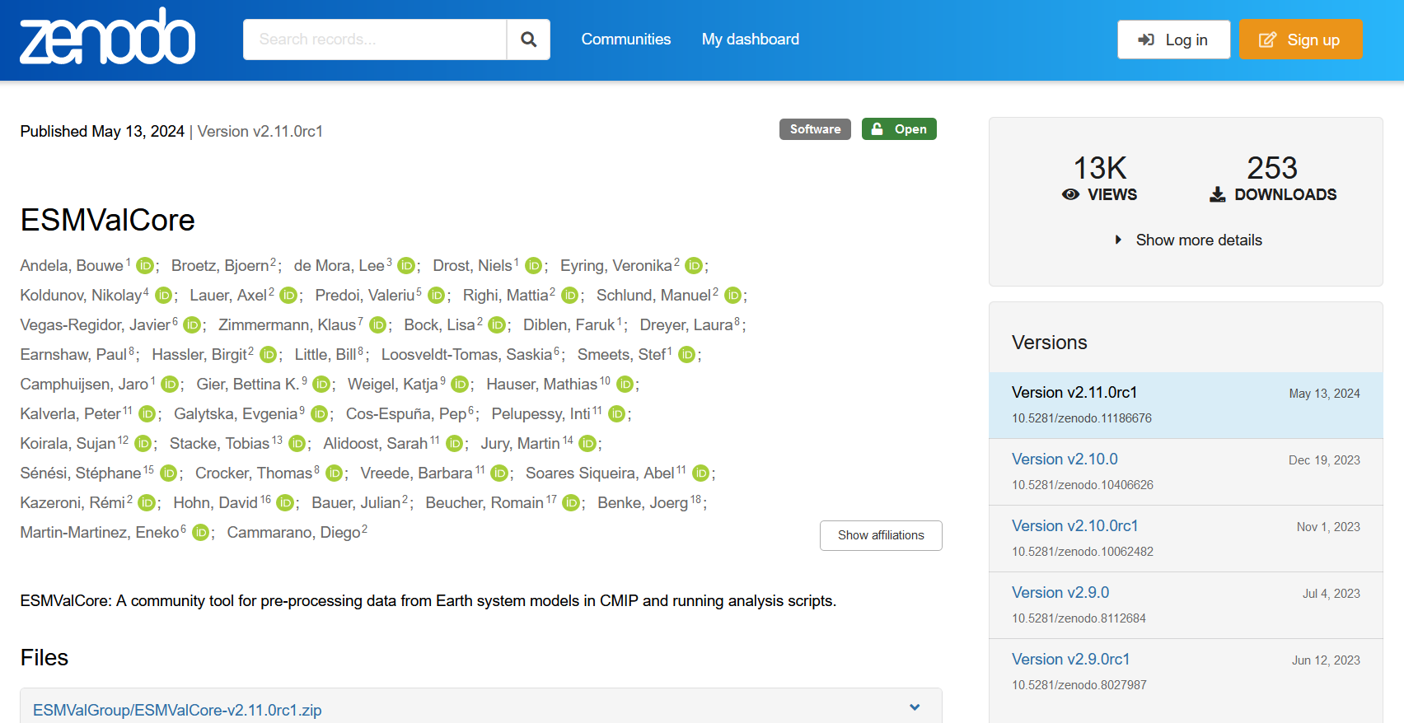
https://zenodo.org/records/11186676
Notes:
+ ... the tagged version of the package is automatically added to Zenodo!

Slide 14

Emma
Notes:
+ We wanted to share some things about the release process that may be worth improving for the benefit of future release managers.

Slide 15
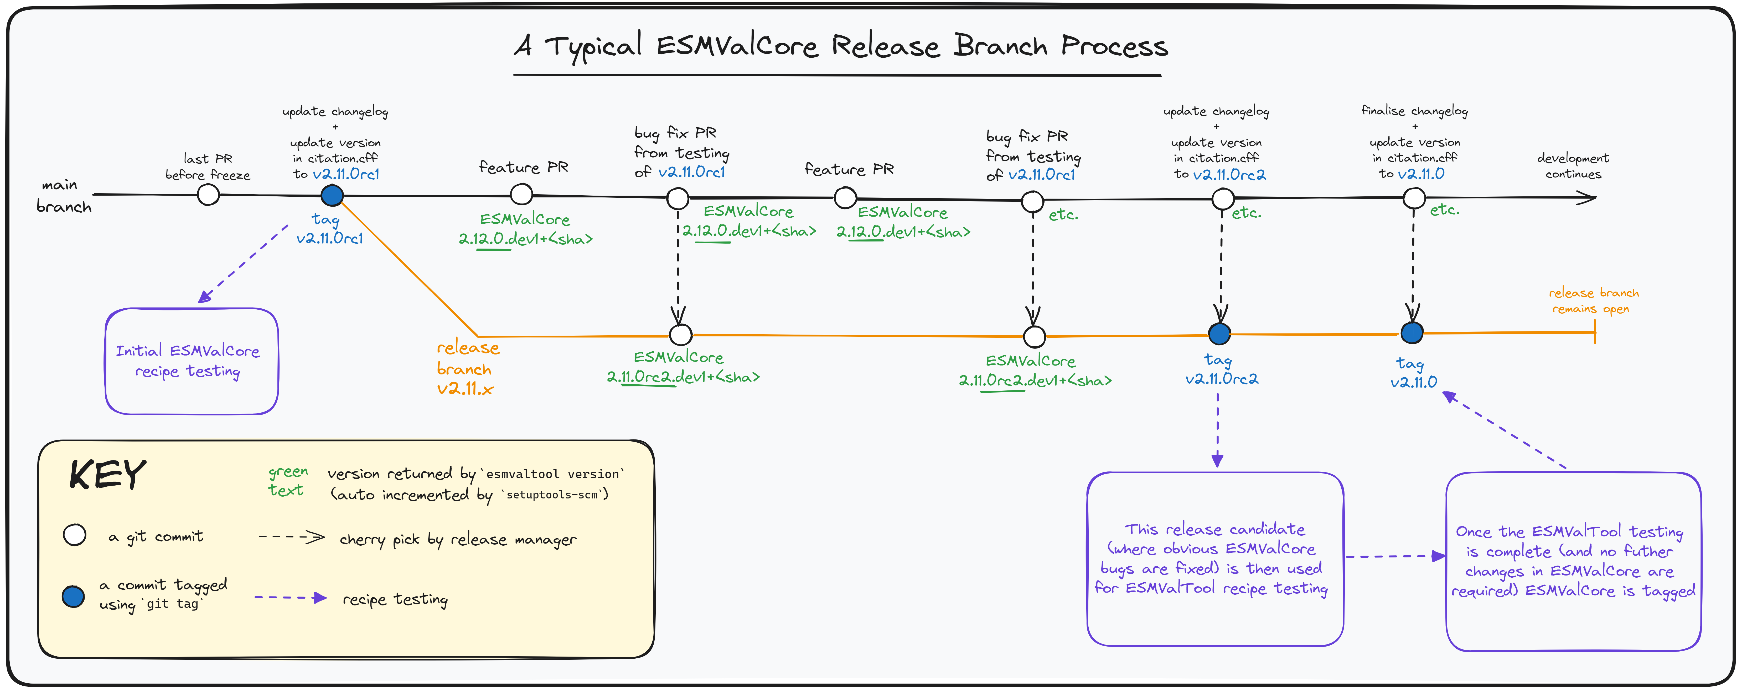
Chris
Notes:
READ title | start, looking at lines and circles
GENERAL IDEA - Git branches, BLACK main branch, ORANGE is the release branch | CIRCLES are commits | WHITE normal commit | BLUE are tagged commits
Rc1 – changelog and citation, then used for testing
(IGNORE green text for now)
KEY PART OF THE PROCESS
Ongoing feature PRs…
bug fixes brought in (feature PRs aren’t)
Obvious Core bugs fixed, move onto testing tool
Green text, versioning – important and automatic (applause for Emma’s friendly robot)

Slide 16

Emma
Notes:
+ We will update the documentation to include Chris’ diagram and the additional details we learnt from Bouwe and V during our conversations for the benefit of future release managers.
+ We are considering creating a “cheat sheet”, prerequisites, troubleshooting, etc.

Slide 17

Emma
2 hours
Notes:
+ We started with the ESMValTool release last Friday.
+ Can you guess how long we spent on it?
+ Ed and Emma spent 2 hours working on the ESMValTool release.

Slide 18
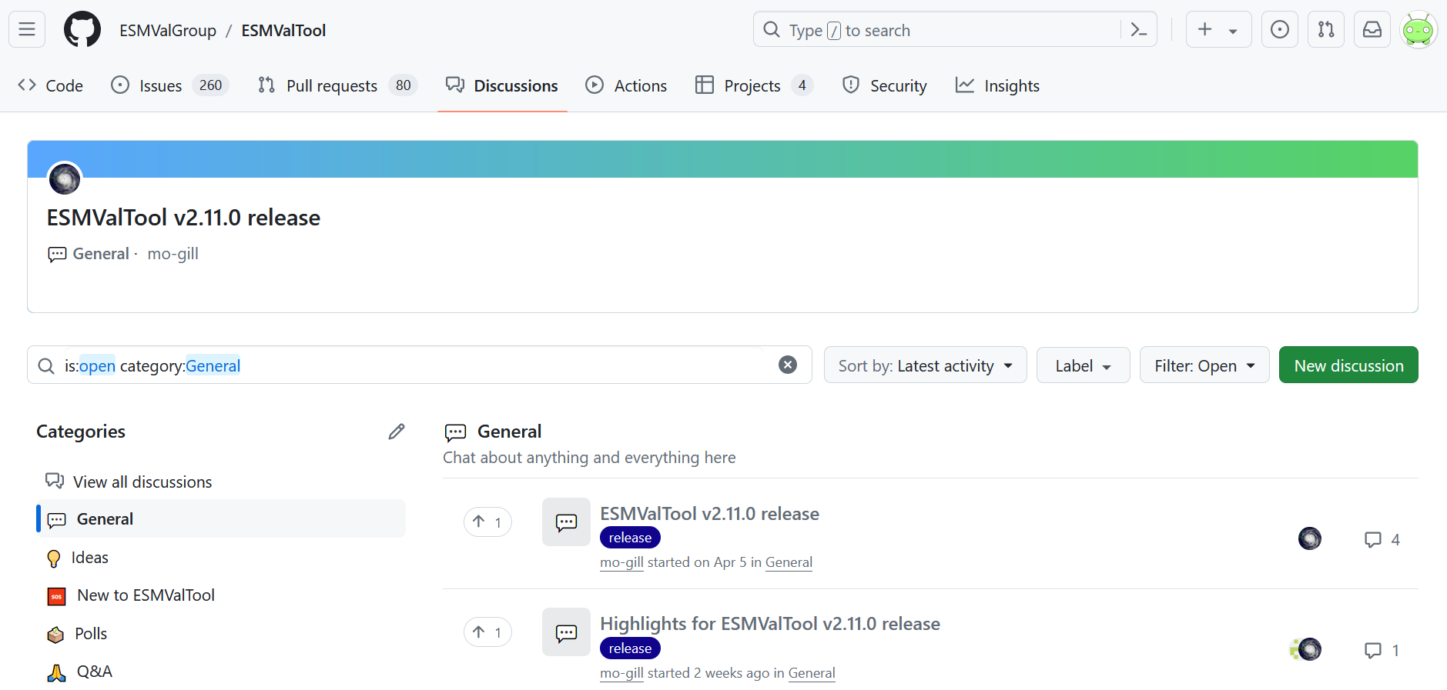
https://github.com/ESMValGroup/ESMValTool/discussions
Notes:
+ Since we have only just started the “ESMValTool v2.11.0 release”, there isn’t much on the discussion, yet!

Slide 19
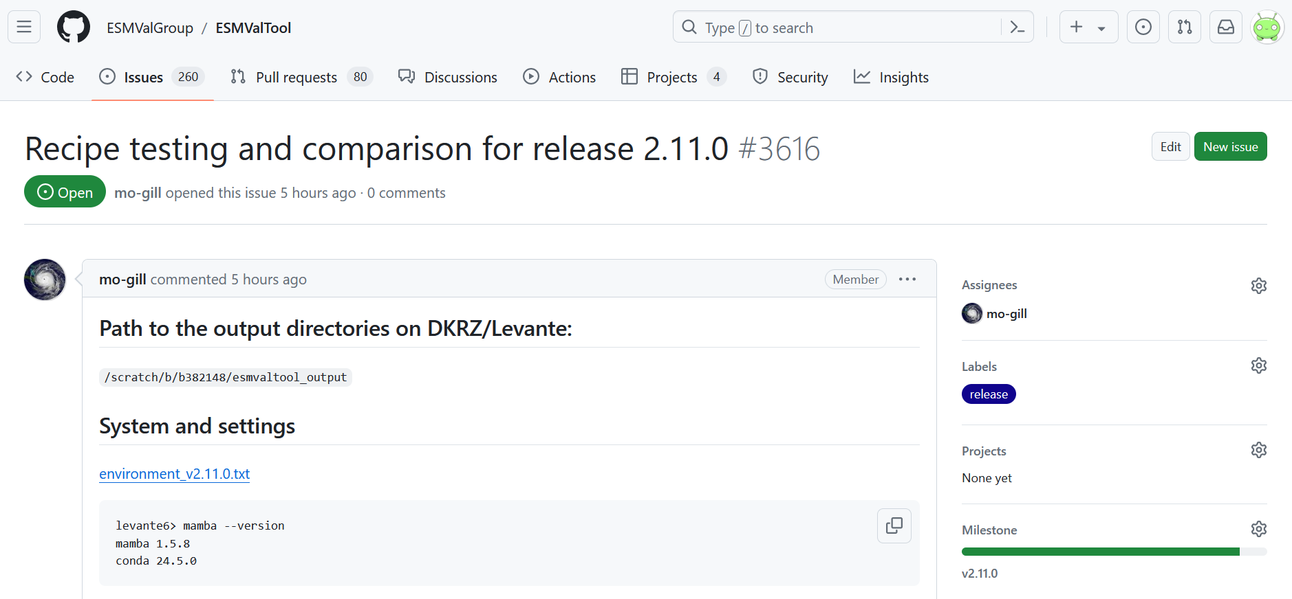
https://github.com/ESMValGroup/ESMValTool/issues/3616
Notes:
+ We have created the issue that will detail the recipe testing and comparison for the ESMValTool v2.11.0 release.
+ The details should be added soon!

Slide 20



Please check your recipes!
Notes:
+ When the details have been added (hopefully later today!), it would be great if recipe maintainers would check their recipes by the end of this week!

Slide 21
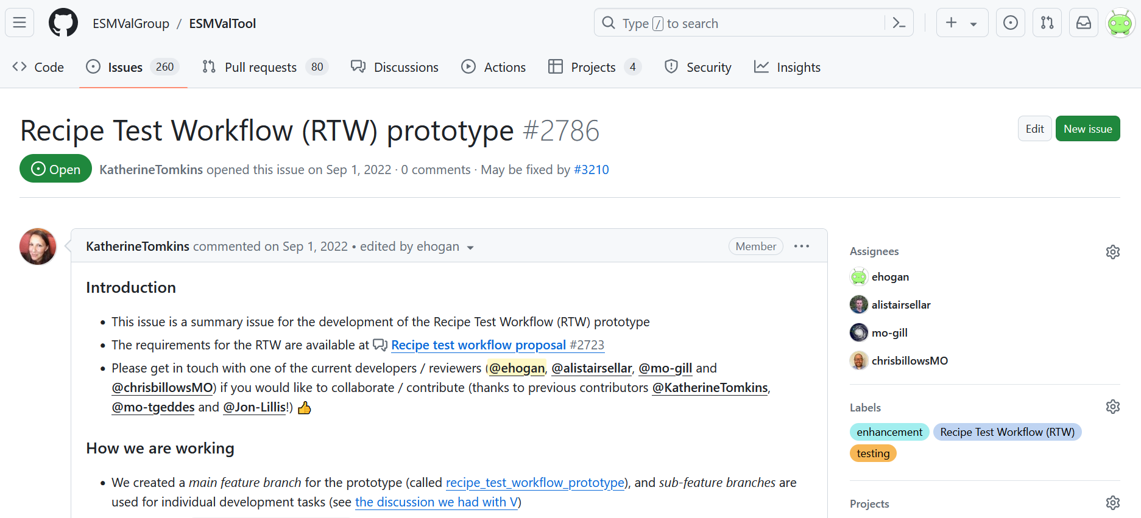
https://github.com/ESMValGroup/ESMValTool/issues/2786
Notes:
+ During the release process, we have also been working on the RTW.
+ The RTW is a Cylc workflow that enables the frequent testing of recipes between releases.
+ This means issues will be identified sooner, making the release process less painful for the release manager.
+ The MO have been working on the RTW prototype since September 2022.

Slide 22
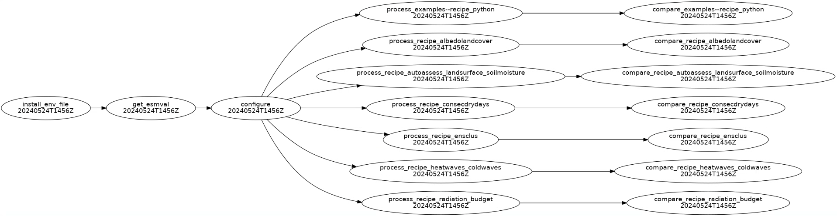
Ed
Notes:
+ This is a cylc graph of the RTW, which details the tasks that are run.
+ The install env file and get_esmval tasks manage the environment used to test the recipes (e.g. at the MO our community environment is used with clones of the latest main branches from ESMValTool and ESMValCore, on JASMIN a container is used)
+ The configure task creates the appropriate (site-dependent) ESMValTool user configuration file.
+ The process tasks runs the recipes.
+ The compare tasks compares the outputs from the recipes to Known Good Outputs, or KGOs.

Slide 23
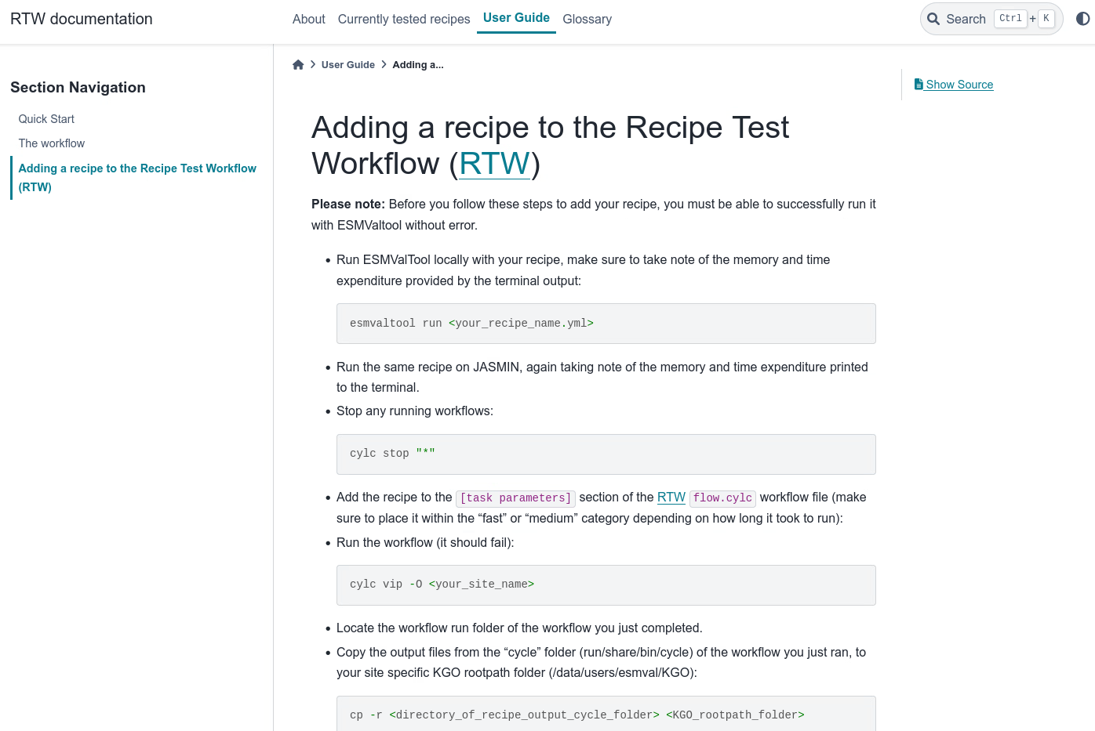
Ed
Notes:
+ One thing I have been working on is adding instructions for people who want to add their recipe to the RTW.
+ This PR is currently in review, if anyone is interested in adding their recipe to the RTW, feel free to join us in the afternoon to discuss.

Slide 24
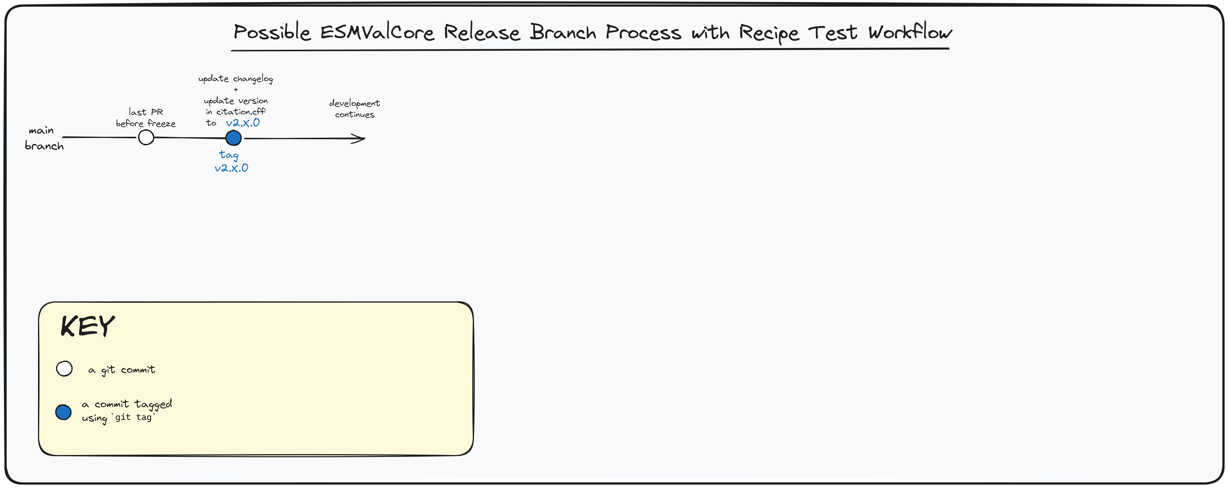



Ed
Notes:
+ This diagram shows what the ESMValCore release branch process might look like with RTW implemented.
+ On that note …

Slide 25

Ed
Notes:
+ ... we recognise that the RTW has been in development for some time now.
+ But we feel the latest developments have completed the prototype.
+ We would love to merge the RTW into main by the end of this workshop so that future release managers can benefit from it.
+ Please join us this afternoon to help review the RTW main feature branch!

Slide 26

Emma
Notes:
+ Many thanks to Bouwe and V for their support throughout the process!
+ The first beer (only!) :P for Bouwe and V tonight are on us!

Slide 27

Emma
Notes:
To summarise, this was the Met Office’s first time performing an ESMValTool release:
+ Automation was great!
+ We will update the documentation for future release managers.
+ Please join us this afternoon to help us review the RTW so that it can be merged into main, or to add your recipes to the RTW.

